Slide 1
Session 19, 20, 21 Saving collections using hibernate

Slide 2
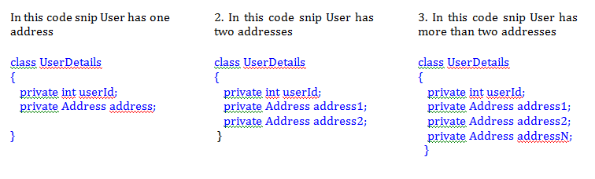
Importance of Collection

Slide 3
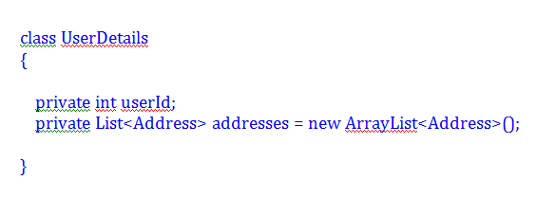
How to use collections
In third case how to manage the records about addresses for that user, now for managing this type of problems we have to use the collection, we do not need to care about how many of the addresses user has. Let’s see there are same changes in the code for that…

Slide 4
Collection Interfaces
Hibernate supports following collection interfaces as value type:
java.util.Set – java.util.HashSet is used to store value.
java.util.SortedSet – java.util.TreeSet is used to store value.
java.util.List – java.util.ArrayList is used to store value. Preserves the position with an index column
Bag semantics – java.util.ArrayList is used to store valre however the position is not preserved.
java.util.Map – java.util.HashMap is used to store value.
java.util.SortedMap – java.util.TreeMap is used to store value.

Slide 5
How it works
Hibernate provides the facility to persist the collections
Hibernate injects the persistent collections based on the type of interface.
The collection instances usually behave likes the types of value behaviour.
Instances of collections are auto persisted if a persistent object refers it and are deleted automatically if it is not referred through.
Elements of collection may shift from one table to another when a persistent object passed the collection to another persistent object.

Slide 6
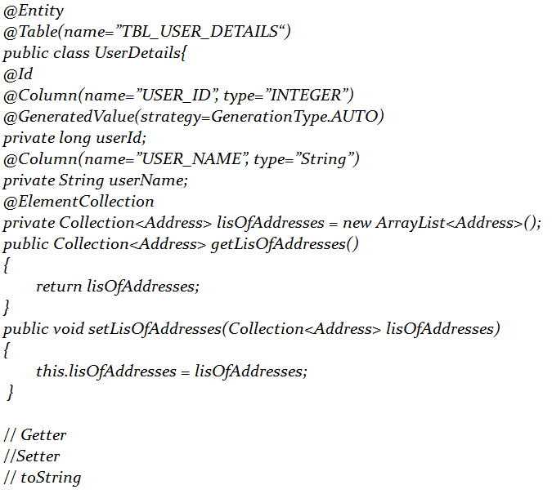
Applying Collections in Persistence
@ElementCollection Target: Fields (including property get methods)Defines a collection of instances of a basic type or embeddable class. Must be specified if the collection is to be mapped by means of a collection table.

Slide 7
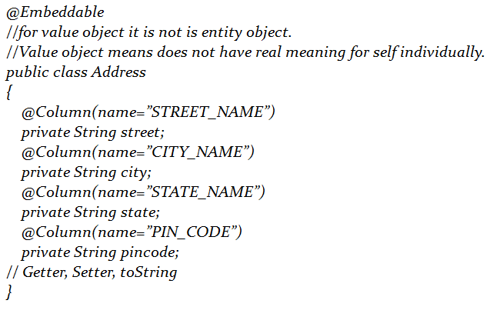
Applying Collections in Persistence

Slide 8
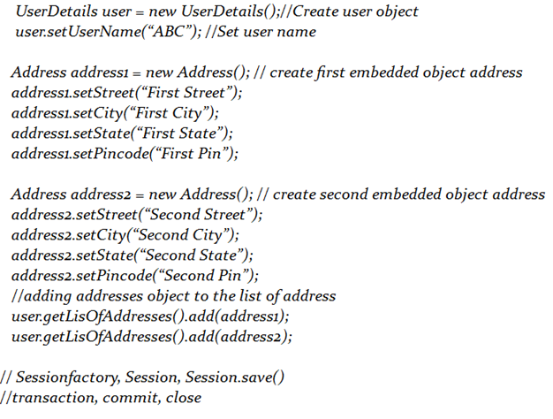
Object retrieving for Persistence

Slide 9
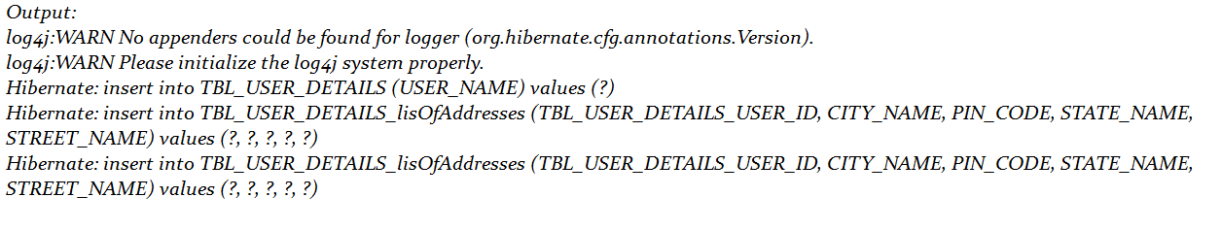
Output for retrieving from DB
Here see that there is one table for the address object created separate for the collection. 1. First Table TBL_USER_DETAILS Saving Collections in Hibernate 2. Second Table TBL_USER_DETAILS_lisOfAddresses Saving Collections in Hibernate with Example Tables In the second table first column TBL_USERS_DETAILS_USER_ID has the user id is foreign key for this table and primary key of the TBL_USER_DETAILS table.

Slide 10
Adding Keys Example
1. TBL_USER_DETAILS for UserDetails entity type object
2. TBL_USER_DETAILS_lisOfAddresses for Address value type object
To overcome this problem we will use annotation @JoinTable.
@JoinTable:
Target:
Fields (including property get methods)

Slide 11
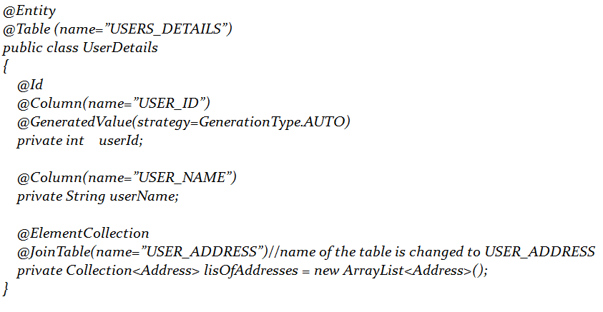
@JoinTable

Slide 12
@JoinColumns
@JoinColumns: Target: Fields (including property get methods)Defines mapping for composite foreign keys. This annotation groups JoinColumn annotations for the same relationship. When the JoinColumns annotation is used, both the name and the referencedColumnName elements must be specified in each such JoinColumn annotation.

Slide 13
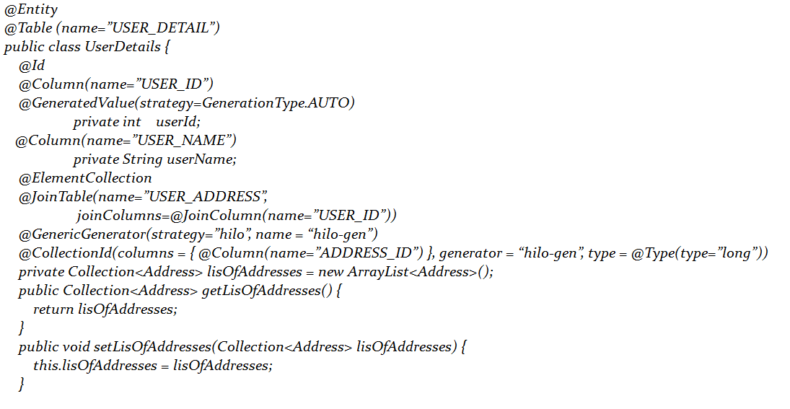
@JoinColumns Ex(Contd...)

Slide 14
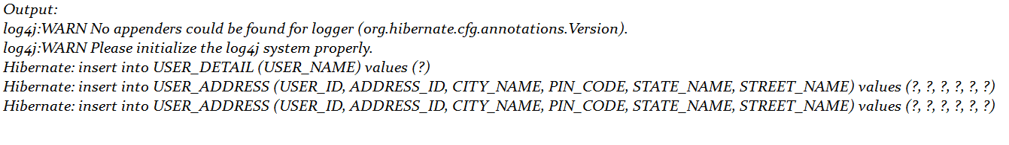
@JoinColumns Output(Contd...)

Slide 15
Proxy Objects
There are two methods in hibernate to get the object from the database
1.get().
when we use get() method to get the object from the database, then the hibernate first check in the session cache if it is available then it is not going to communicate with data base otherwise it communicate with database retrieving the object from the database and store its real object in session cache and finally the object return to the Application.
2.load().
when we use load() method to get the object from the database then if that object is not available in session cache then hibernate communicate with database and retrieving the proxy of that object not real object, and store there proxy object in the session cache. when ever we use that object then hibernate provide real object.
the proxy object retrieving by the load method in hibernate is called hibernate proxy. An object proxy is just a way to avoid retrieving an object until you need it.

Slide 16
Why Proxy ???
Now question is this what about the field listOfAddress field, Is it also have the value?
if you say yes so what about cost of memory ?
if you say no so how to retrieve the value associated with that field the address table in the database on demand.

Slide 17
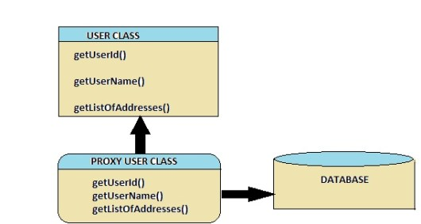
How Proxy Works

Slide 18
How Proxy Works (Contd)
Hibernate 2 does not proxy objects by default.
Default in Hibernate 3.
In Hibernate 3, when we fetching the user object from the database actually its retrieved the proxy object of the user class means only first level of the fields are initializing with the associated values from the database.
Field listOfAddresses does not have the value.
If you want the list address you should call the following method you will get the listOfAddresses.
user.getListOfAddress();
this return the list of the address associated with that particular user which name is XYZ this is the default behaviour of the Hibernate 3.

Slide 19
Fetching strategies
Two types of the fetching strategies in the hibernate.
1. Lazy Fetch type LAZY = fetch when needed
2. Eager Fetch type EAGER = fetch immediately

Slide 20
1. Lazy Fetch Type(default in v3)
Now when you load a User from the database, JPA loads its id, name, and address fields for you. But you have two options for users: to load it together with the rest of the fields (i.e. eagerly) or to load it on-demand (i.e. lazily) when you call the user’s getListOfAddresses() method.
The purpose of Lazy strategy is memory optimization . When I say memory optimization it means it means it saves us from heap error.
When a user has many addresses it is not efficient to load all of its addresses with it when they are not needed. So in suchlike cases, you can declare that you want addresses to be loaded when they are actually needed. This is called lazy loading.

Slide 21
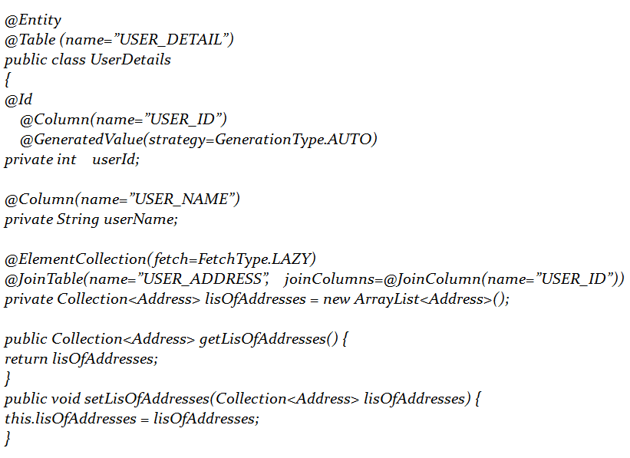
Lazy fetch Example

Slide 22
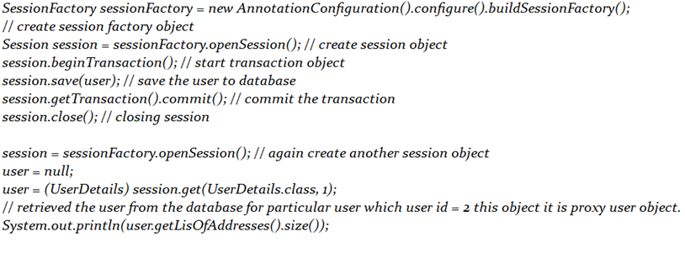
LAZY fetch for Retrieving Object

Slide 23
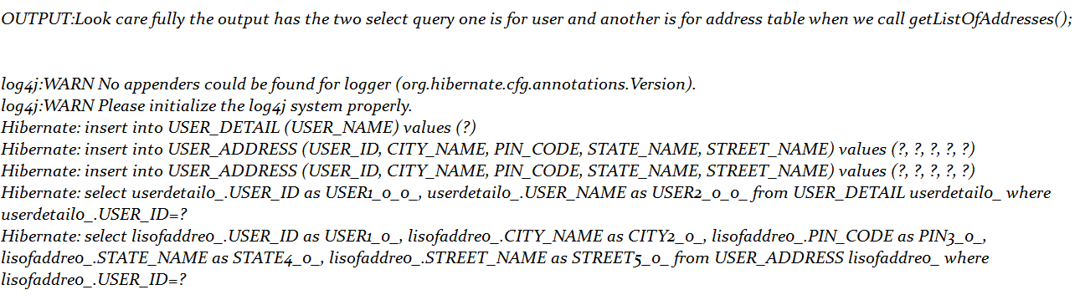
Output(LAZY fetch)

Slide 24
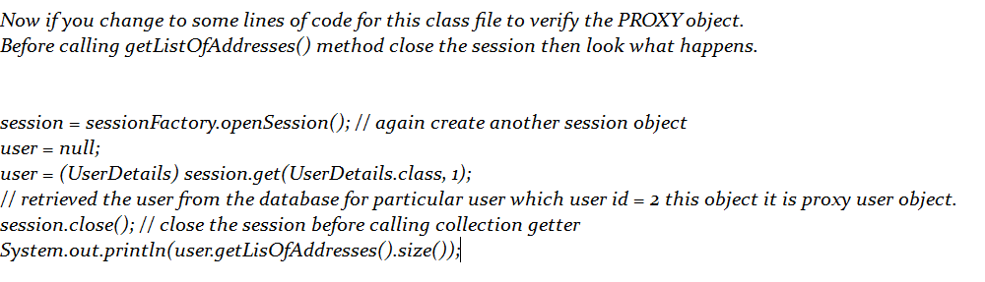
Changes applied for LAZY fetch

Slide 25
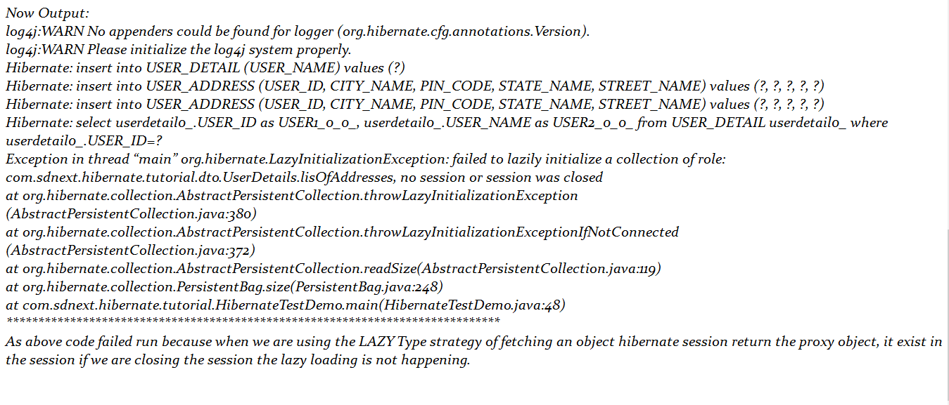
Output changes after apply

Slide 26
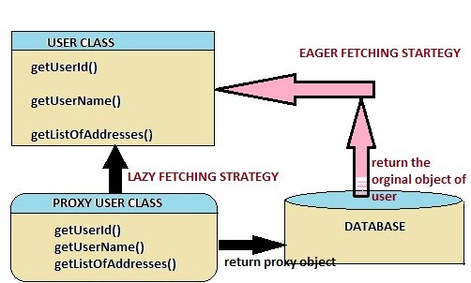
2. Eager Fetch Strategy
In hibernate 2 this is default behaviour of the to retrieving an object from the database.
Eager/Join Fetch strategy:- Join Fetch strategy the eager fetching of associations.
The purpose of Join Fetch strategy is optimization in terms of time.
I mean even associations are fetched right at the time of fetching parent object.
So in this case we don’t make database call again and again . So this will be much faster.
Agreed that this will bad if we are fetching too many objects in a session because we can get java heap error.

Slide 27
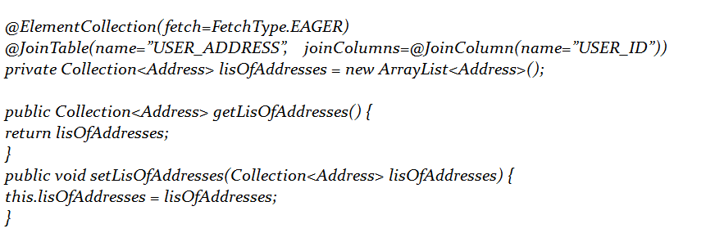
Eager fetch Example

Slide 28
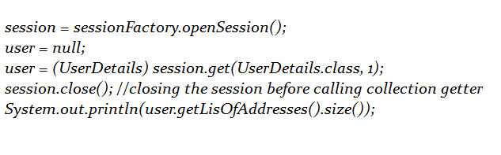
Eager fetch retrieving object

Slide 29
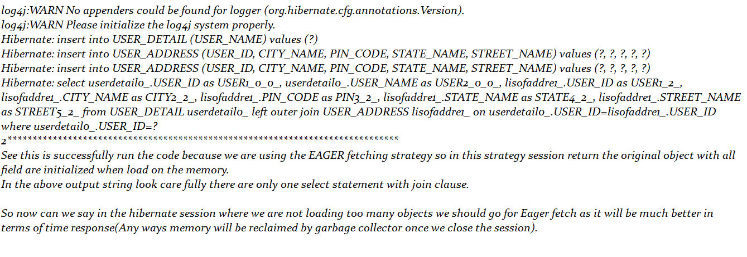
Output for retrieving object

